Slide 1
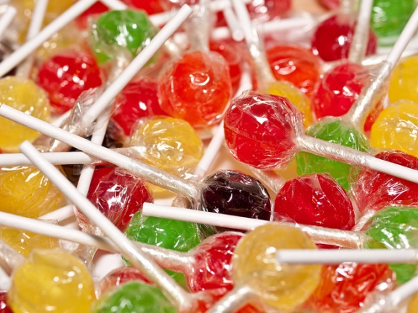

I need 30 lollies
You can buy a 10 pack for $6 and a 15 pack is $8.
How many packets of each does do I need to buy to get 30 lollipops? How much will it cost?
Notes:
hook

Slide 2
I need 30 lollies
You can buy a 10 pack for $6 and a 15 pack is $8.
How many packets of each does do I need to buy to get 30 lollipops? How much will it cost?
The answer is to buy two 15 packs, which costs $16

Slide 3
Lesson objective
By the end of this lesson you will be able to;
- Compare the price of different items to determine which is the best value
Notes:
Lesson

Slide 4
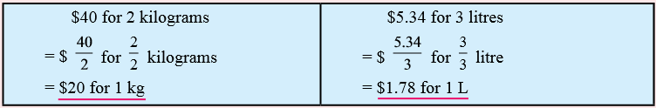
24
7
30
Date
Best buy
EQ – How can we avoid being ripped off?
The unitary method is a useful method for comparing one rate with another rate.
Step 1 – Find the unit rates for a single quantity and compare the results
Find the rate for one in each of the following:
5
Notes:
Lesson objective (EQ)

Slide 5
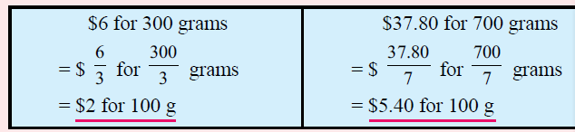
24
7
30
Date
Best buy
EQ – How can we avoid being ripped off?
To compare prices you don’t have to use the unitary method as long as you make them the same unit like cost for 100g ($/100g)
The best buy would be the $6 for 300g
5
Notes:
They don’t need to copy everything down

Slide 6
Which is the best buy?
Notes:
Guided practice
Go through the solutions with the students

Slide 7
Practice
Page 54
Exercise 4.5
Notes:
Independent practice

Slide 8
Summary
Quickwrite:
What are the steps to calculating best buy?
Share with pair:
Share with the class:
Notes:
Closure

